Slide 1
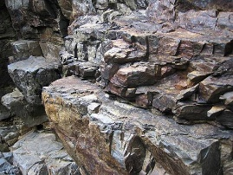
Science Homework Due 11/18/19
We learned “Solids always have a shape, no matter the container! Some are hard, some can break but solids always hold their shape!”
Look at the properties of solids listed on the bottom of the page. Go on a solid matter hunt to find solids that match these properties. Search through old magazines/newspapers for pictures of solid matter. Cut out the pictures and neatly glue them to the page. You could also draw examples if you would like!
Remember to label the property on the front of the page.
Hard solid
Soft solid
Green solid
Sticky solid
Sour Solid
___________ Solid (list a property of your choice and find solid matter that will match!)
Ex:
Round Solid (ball) Bumpy Solid (rocks)

Slide 2
Name______________________________________________ Class______________________
All About Solids

