Slide 1
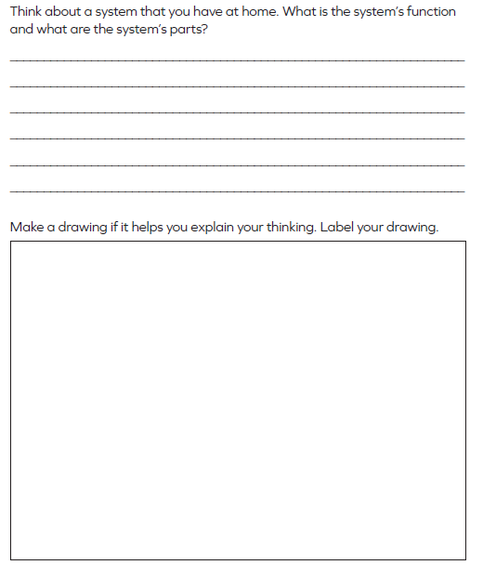
Name______________________________ Class_________
Science Homework due 9/23/19

