Slide 1
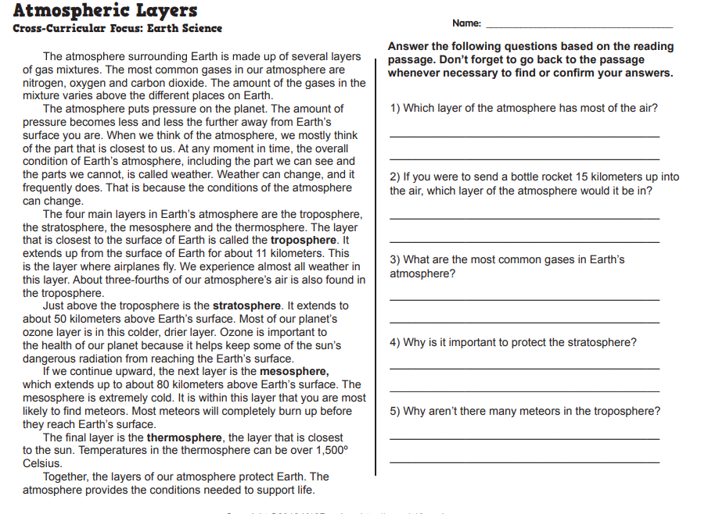
Name______________________________________ Class________________ Science Homework due 3/16/20
.

