Slide 1
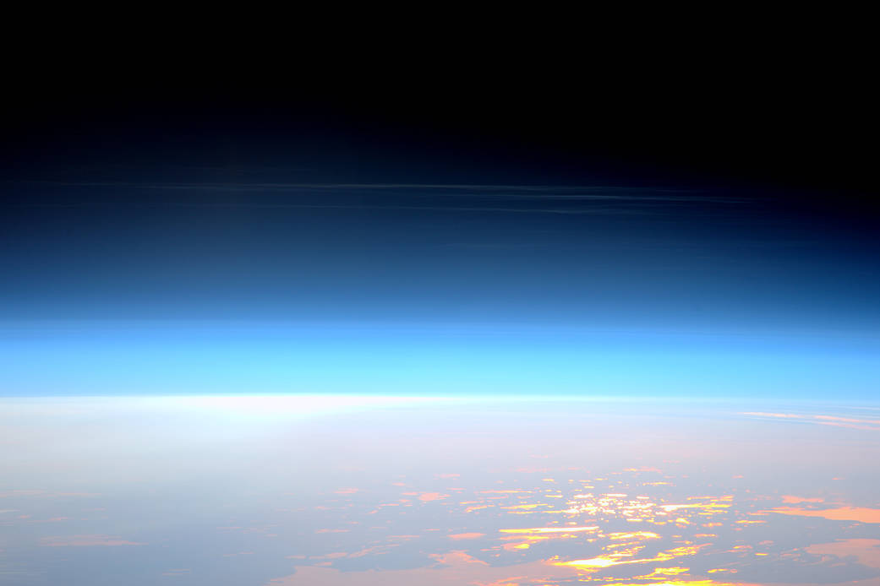
All About Earth’s Atmosphere
Use the presentation to help you collect notes in your organizer. Your notes will be evidence you can reference in our class discussion!

Slide 2
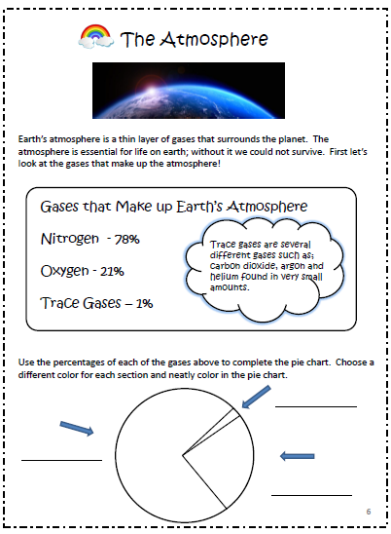
Review this page first. Take a few minutes to complete the pie chart and identify the types of gases that are in our atmosphere.

Slide 3
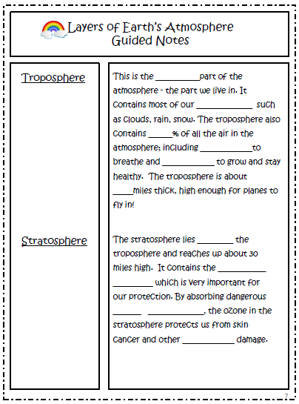
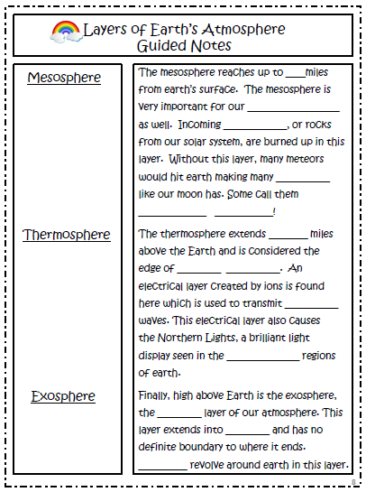
These note taking pages will help you with our discussion. Use the presentation to help you find the important information.

Slide 10
Layers Of Atmosphere | The Dr. Binocs Show | Educational Videos For Kids
Watch the video to learn more! Add additional notes on your note taking pages for new information you would like to bring to the discussion!
Click on the image to access the video ☺

