Slide 1
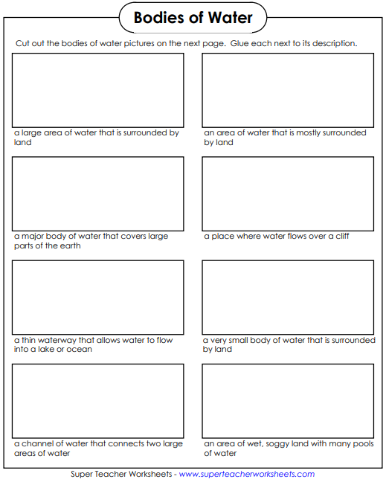
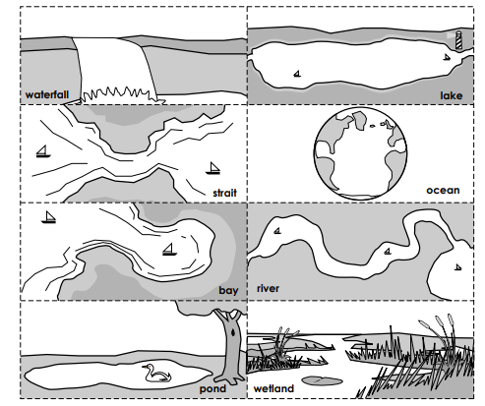
Name__________________________________________ Class_________ Science Homework Due TUESDAY 1/21/20
Directions: Match the body of water picture to its description. If you’re having trouble, use a dictionary or the internet (with the help of an adult) to help you! If you do not have scissors to cut and glue, use the images as your “word box” and write your answer instead of pasting.

