Slide 1
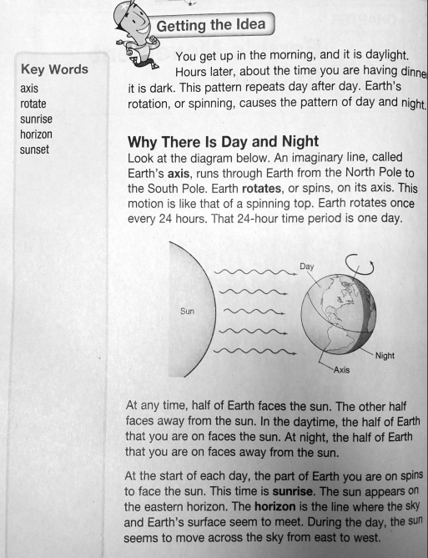
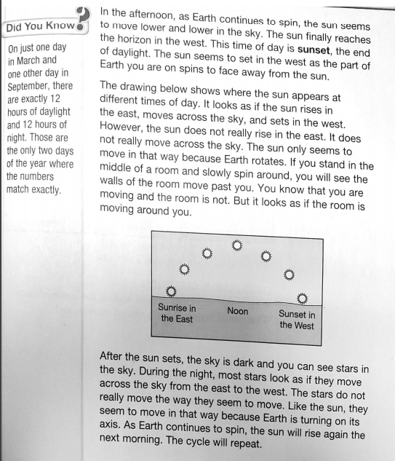
Name______________________________________ Class________________ Science Homework due 3/16/20
Directions: Read the passage. Answer the multiple choice and short answer questions.
.
OVER

Slide 2
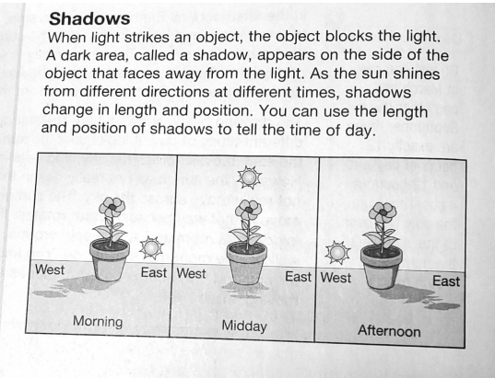
Name______________________________ Class________________ Science Homework due 3/16/20
Directions: Read the passage (starts on the other side of the paper) . Answer the multiple choice and short answer questions.
Multiple Choice: Circle the best answer.
Around what does Earth rotate?
A. The sun B. its axis
C. the equator D. its horizon.
2. How long does Earth take to rotate once?
A. 12 hours B. 20 hours
C. 24 hours D. 36 hours
3. As Earth spins, the part facing the sun has?
A. spring B. darkness
C. Daylight D. summer
Short Answer: Write your answer in the space provided.
What would happen to day and night if Earth rotated faster?
2. What would happen if Earth rotated more slowly?
4. Where does the sun set?
A. In the north B. in the east
C. In the south D. in the west
OVER

