Slide 1
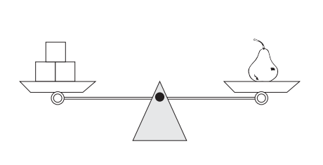
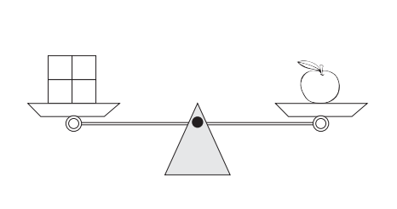
Name___________________________________________ Class______________
Science Homework Due 11/12/19
In Science, we have been learning all about matter. Matter is anything that takes up space, and has mass. We use a balance scale to measure the mass of objects. We add the value of each weight together to find the total mass. We tell our answer in grams. Find the mass of each object. Record your answer in grams. Use the work space next to each problem to solve the problem.
Work Space:
The mass of one pear is _________________
Work Space:
The mass of one apple is _____________
1.
5G
10G
10G
2.
4G
4G
4G
4G
TURN OVER!

Slide 2
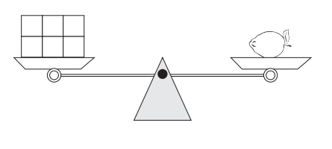
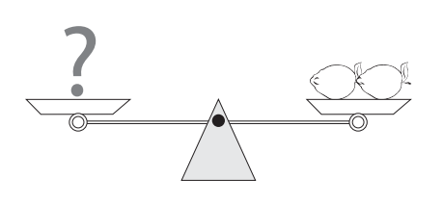
Work Space:
The mass of one lemon is ______________
CHALLENGE: What is the mass of 2 lemons and 1 apple?
Work Space:
3.
10G
10G
5G
1G
1G
1G

