Slide 1
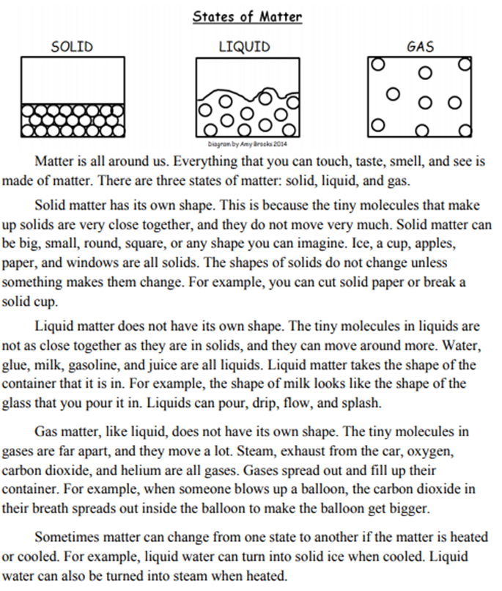
Name____________________________ Class____________
Science Homework Due 11/18/19
Directions: Read the passage. Choose 6 of the questions from the back of this page to answer. Extra Credit: Answer all 12 questions!

Slide 2
