Slide 1
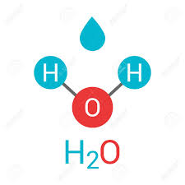
Name________________________ Class______ Science HW due 10/15/19
Directions: Read the passage. Answer the questions on the back using the details from the text.
What is the difference between atoms and molecules? It is actually pretty simple. Molecules are made up of atoms. Each element on the periodic table of elements is made up of one single type of atom. Molecules are formed when atoms bond. Different types of atoms can form together to make a molecule. Two or more of the same type of atom can also be bonded to make a molecule.
For example, H is the symbol for hydrogen and O is the symbol for oxygen. Water is made up of both hydrogen and oxygen. H2O is the symbol for water. Two hydrogen atoms and one oxygen atom are bonded together to create a water molecule. Oxygen gas is made up of two oxygen atoms bonded together. O2 is the symbol for an oxygen molecule.
With so many elements, imagine all the combinations of atoms that have been researched and have yet to be researched. Chemistry is very complicated because there are so many different combinations.

Slide 2
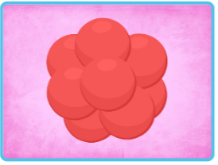
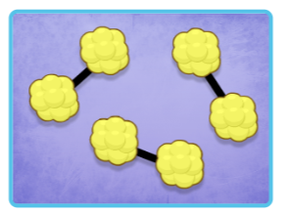
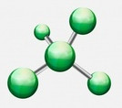
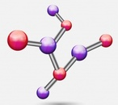
Name_____________________________________ Class______ Science HW due 10/15/19
Directions: Read 1-4. Circle the best choice. Then label the pictures “atom” or “molecule.”
1. Water molecules are made up of
A. any two atoms bonded together.
B. two hydrogen atoms and one oxygen atom.
C. atoms of only one type of element bonded together.
D. two oxygen atoms.
2. Can a single atom be considered a molecule?
A. only if the atom is found in water
B. no, it takes two or more atoms bonded
to create a molecule
C. only if it is an oxygen atom floating in
the air
D. yes, all atoms are made up of many
different molecules
3. Read the following sentence: "Chemistry is very complicated because there are so many different combinations." The word complicated means
A. simple and basic
B. difficult to understand
C. fun and exciting
D. able to be learned easily
4. What is the main idea of this passage?
A. Bonded atoms make up molecules.
B. Atoms and molecules are unrelated to each other.
C. Water is the most common type of molecule.
D. Oxygen and hydrogen are necessary for molecules.
Atom or molecule?
Label the pictures.
1. 2.
3. 4.

