Slide 1
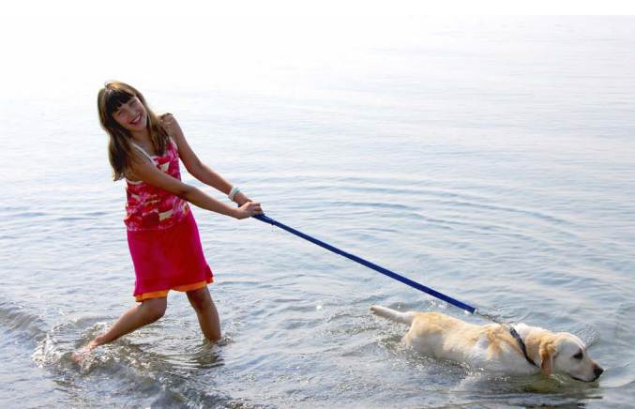
Name___________________________________________ Class ________
Science Homework due 11/12/19
Read the passage on the opposite side first. Then answer the questions.
Look at the picture below. Write 1 qualitative observation, 1 quantitative observation, and 1 inference.
Qualitative Observation ____________________________________________
________________________________________________________________
Quantitative Observation ___________________________________________
________________________________________________________________
Inference________________________________________________________
________________________________________________________________

Slide 2
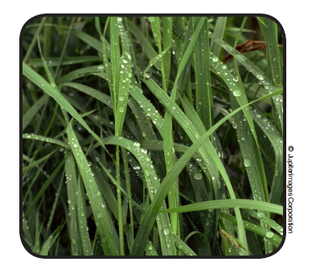
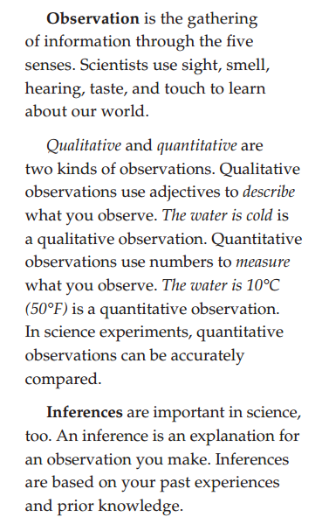
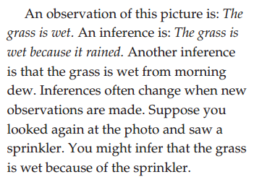
Name___________________________________________ Class ________
5th Grade Science Homework Due 11/12/19
Directions: Read about observations and inferences. Complete the activity on the back for homework.
Questions? Email me at dyosevitz@schools.nyc.gov

