Slide 1
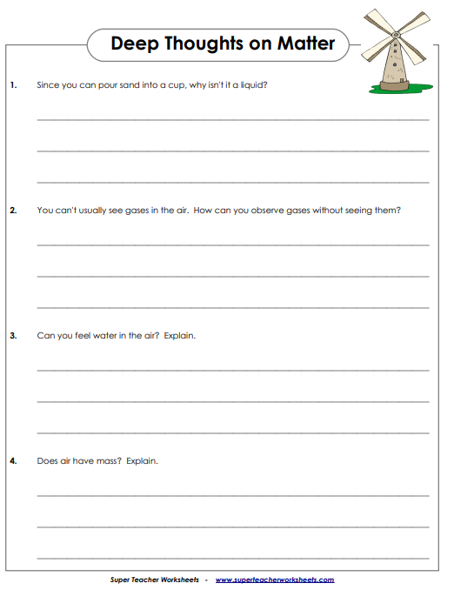
Name________________________________ Class__________
Science Homework Due 11/25/19

