Slide 1
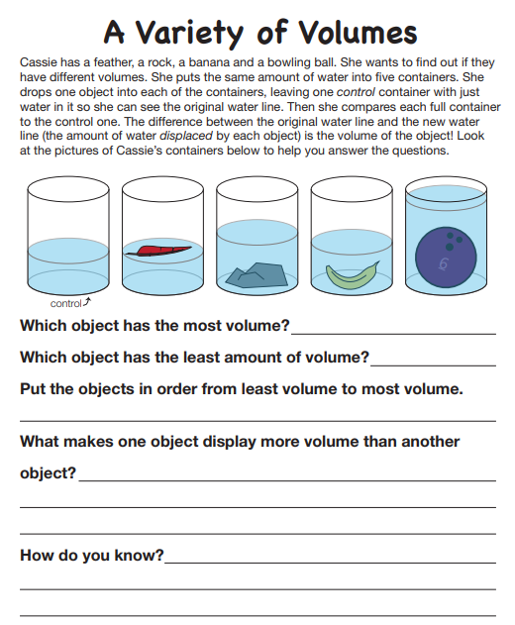
Name____________________________ Class__________
Science Homework due 11/11/19

