Slide 1
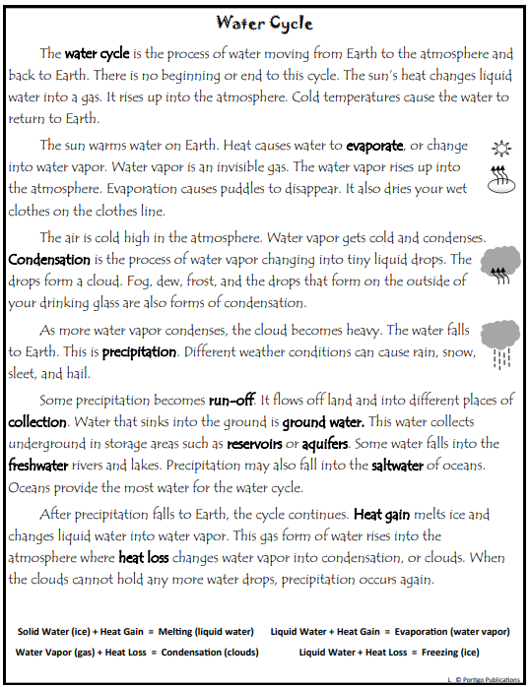
Name________________________________ Class_____________
Science Homework Due 1/13/20

Slide 2
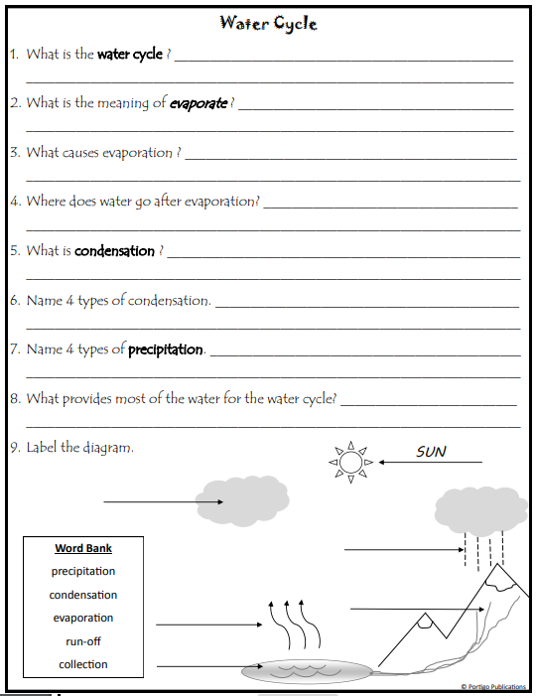
Name________________________________ Class_____________
Science Homework Due 1/13/20

