Slide 1
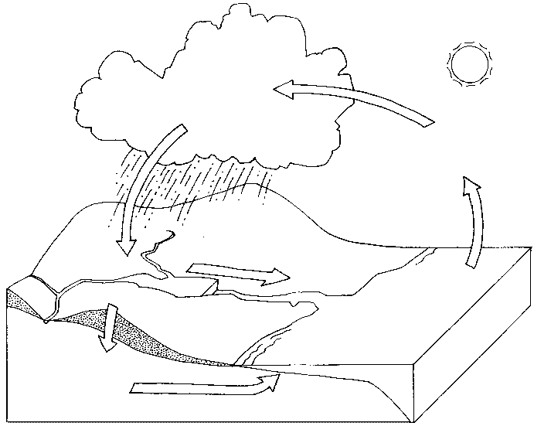
Name______________________________________ Class ___________
Please review vocabulary and facts for a test on January 24, 2020
Water Cycle and Weather Vocabulary
Weather- the condition of the air around us.
Water cycle – the process by which water moves from the surface of the Earth to the air and then back again.
Evaporation – when liquid is heated and changed into a gas.
Water vapor – the gas form of water.
Condensation – when gas cools and is changed into a liquid.
Precipitation – water that falls back to Earth’s surface. There are 4 types of precipitation- rain, snow, sleet, and hail.
Ground water –water that is absorbed into the soil.
Run off- water that is not absorbed into the soil. It flows into a larger body of water.
Water Cycle Diagram
condensation
precipitation
evaporation
run off
ground water

Slide 2
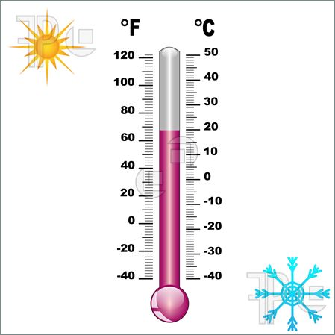
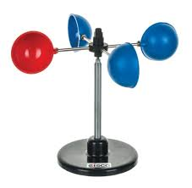
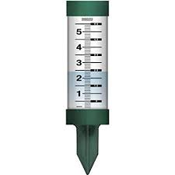
Thermometer- Science tool used to determine how hot or cold something is.
Anemometer- tool used to measure wind speed.
Weather Vane- tool used to measure the
direction in which the wind is blowing.
Rain Gauge- tool used to measure the amount of rain fall (measured in inches).
*F count each line by 2s
*C count each line by 1s
68 F
20 C

Slide 3
Other Important Facts:
Clouds form when condensation reaches the cool atmosphere, and collects on dust particles in the sky.
Condensation can be seen all around us! When your bathroom mirror is foggy after a shower, that is condensation. When your soda cup develops water on the OUTSIDE of the cup, that is also condensation! Condensation likes to collect in cold places. That’s why the gas changes back into water high in the sky…it’s cold up there!
The sun powers the water cycle. Without the sun, the water cycle would never begin!
Too much runoff can cause floods. Floods can be dangerous. Floods can also cause pollution to clean water, mud slides, and even plants to become uprooted. This can be a problem for animals that rely on plants for food and for shelter.
Not enough water can cause a drought. The soil becomes very dry and dusty.
Thermometers have 2 sides – Fahrenheit and Celsius.
The United States relies on the Fahrenheit side of the thermometer; other countries and scientists around the world rely on the Celsius side of the thermometer.
The red liquid in a thermometer will rise when it is warm and fall down when it is cool.
Water cycle song (She’ll Be Comin’ Round the Mountain)
Water travels in a cycle yes it does (2X)
It goes up as evaporation
Forms a cloud as condensation
Then pours down as precipitation, yes it does!
Precipitation rhyme (The Mail Carrier’s Motto)
Rain, snow, sleet or hail - you will always get your mail!

